Slide 1
PEC: CODE BLOODED 4.0
TEAM: THE GRIND
P3: JSON TRANSFORMATION

Slide 2
Introduction
The Task:
Build an app that will generate the transform the target JSON structure from source JSON structure based on the mapping, while being generic enough to accept different source/target/mapping inputs dynamically.
The Solution:
The Grind’s Awesome JSON Transformer is a Full-Stack application that provides a GUI to the user to feed the Mapping and the source JSON files. It provides the user with an easy method to transform their source JSONs to their own format.

Slide 3
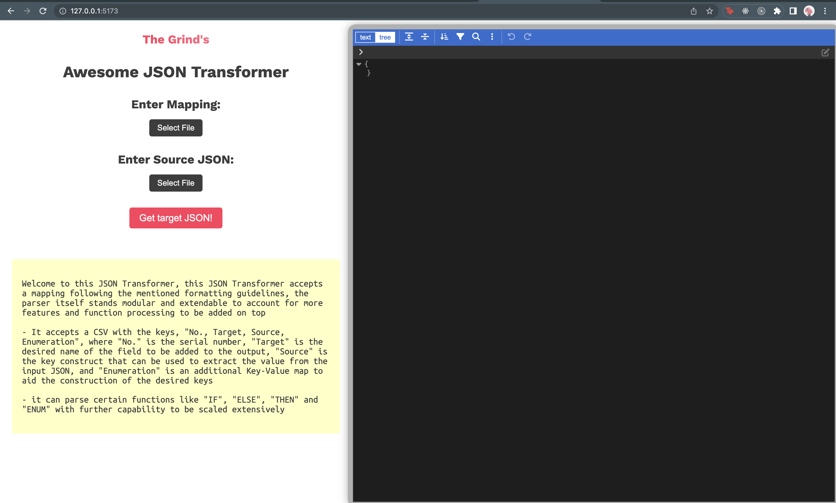
Our App

Slide 4
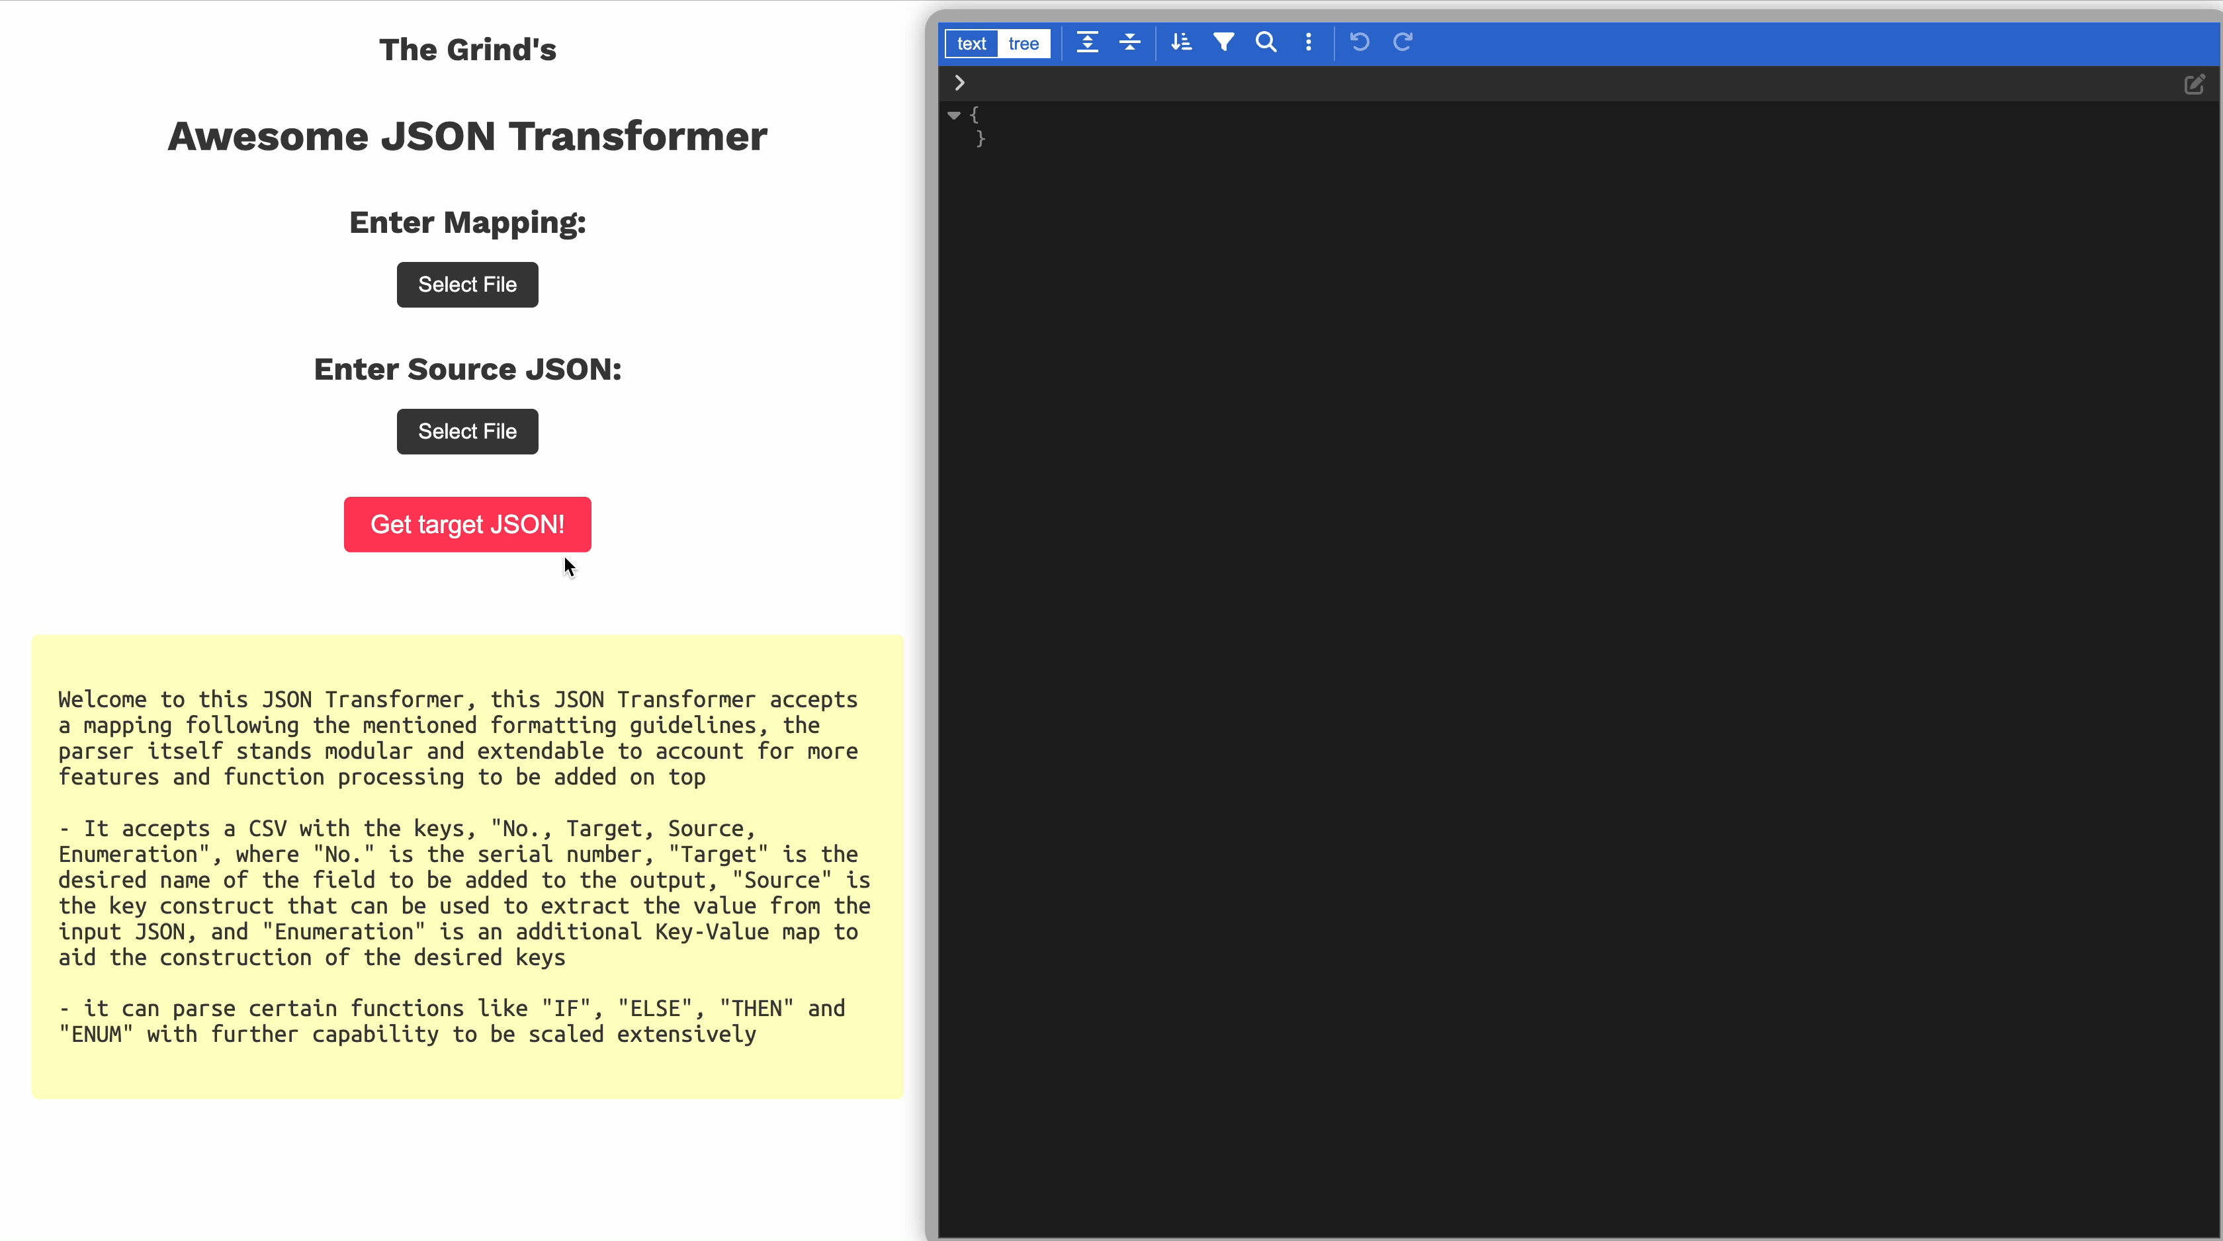
User Flow

Slide 5

The backside of the kitchen :D

Slide 6
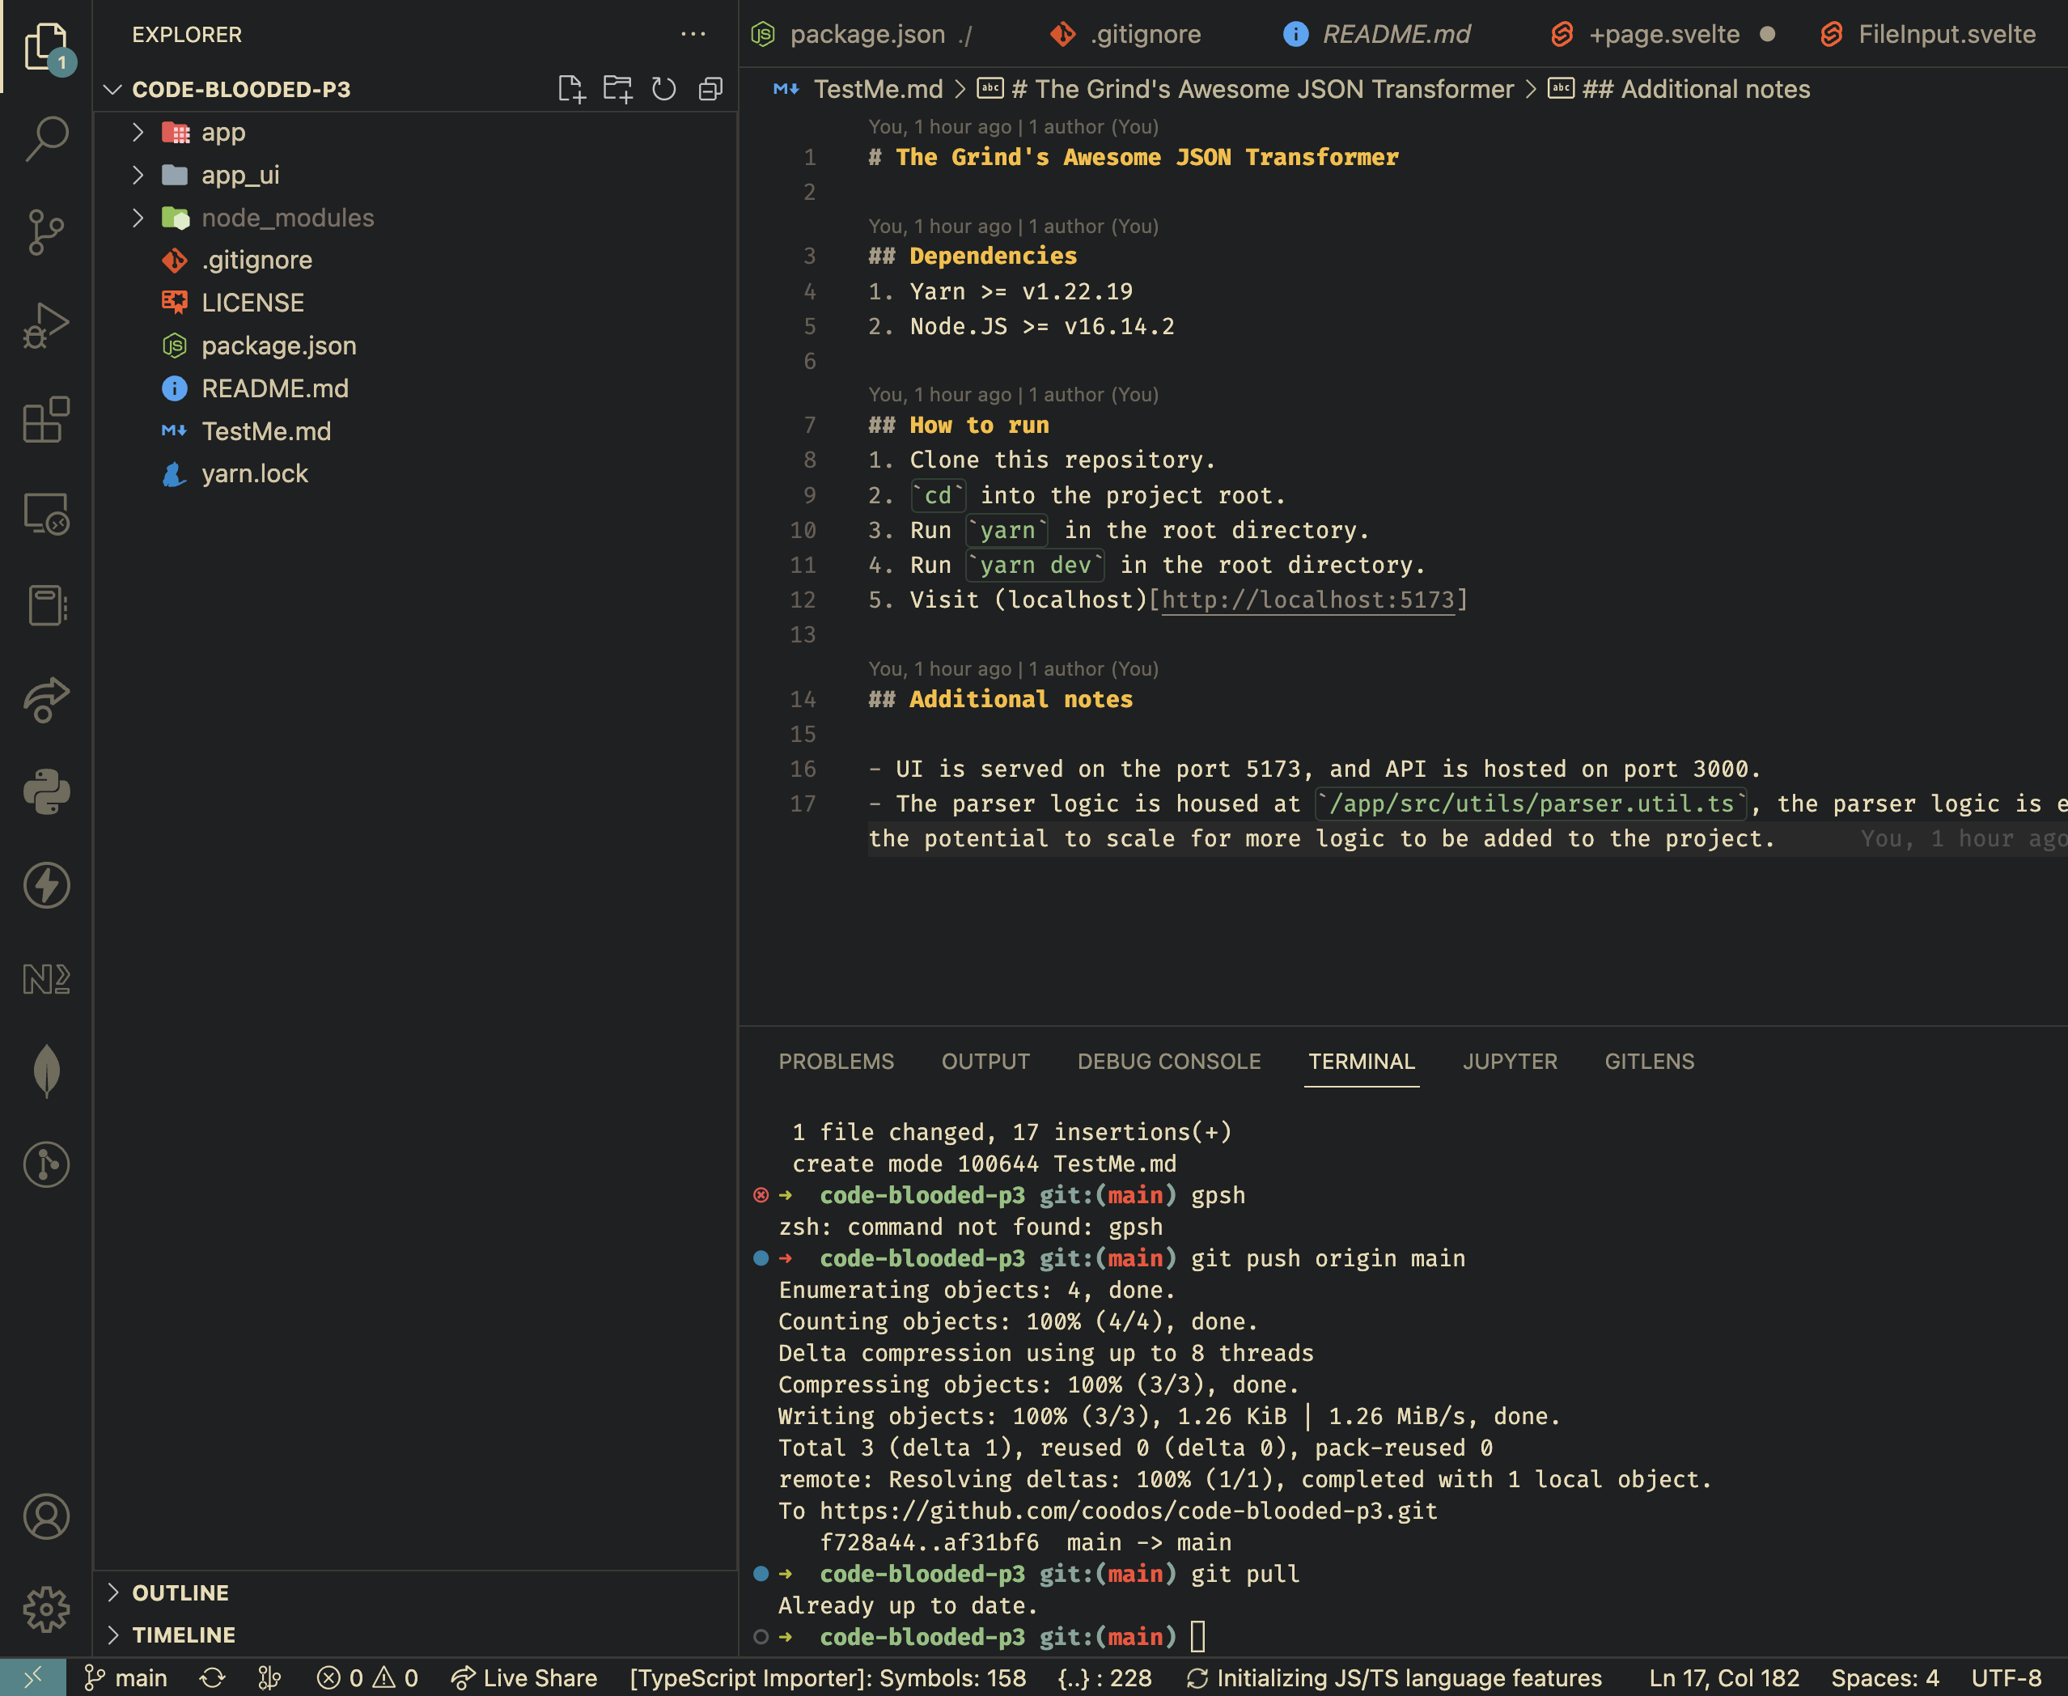
Project
Our project is based on typescript which makes it ultra stable to be deployed into a production environment instantly.
The project is clearly separated into the app & app_ui directories according to hackathon guidelines for the front-end and back-end respectively.

Slide 7
The Frontend

Slide 8
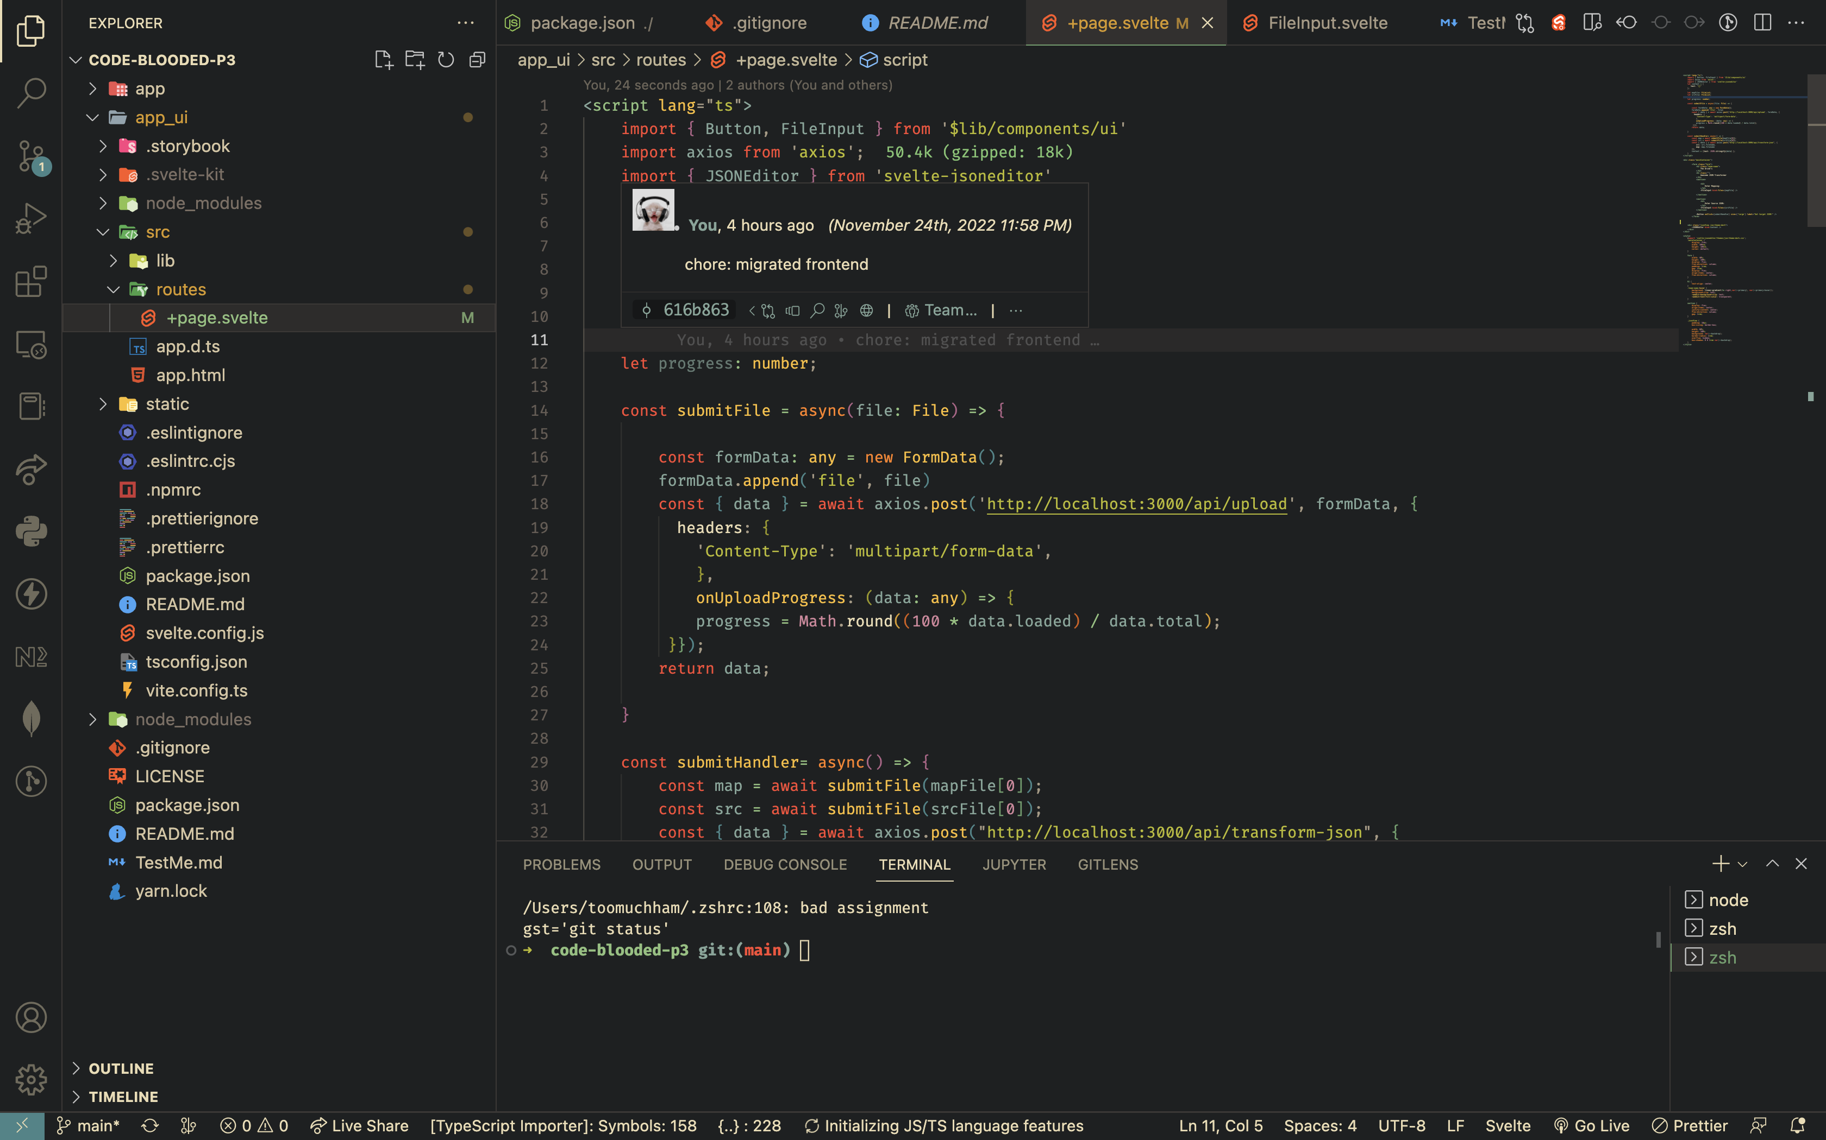
Frontend
Our beautiful yet minimalistic front-end has been designed to perfection with Svelte.
We chose Svelte for our frontend as it’s remarkably fast over other technologies like React, and for it’s sugary sweet syntactic sugar.

Slide 9
The Backend

Slide 10
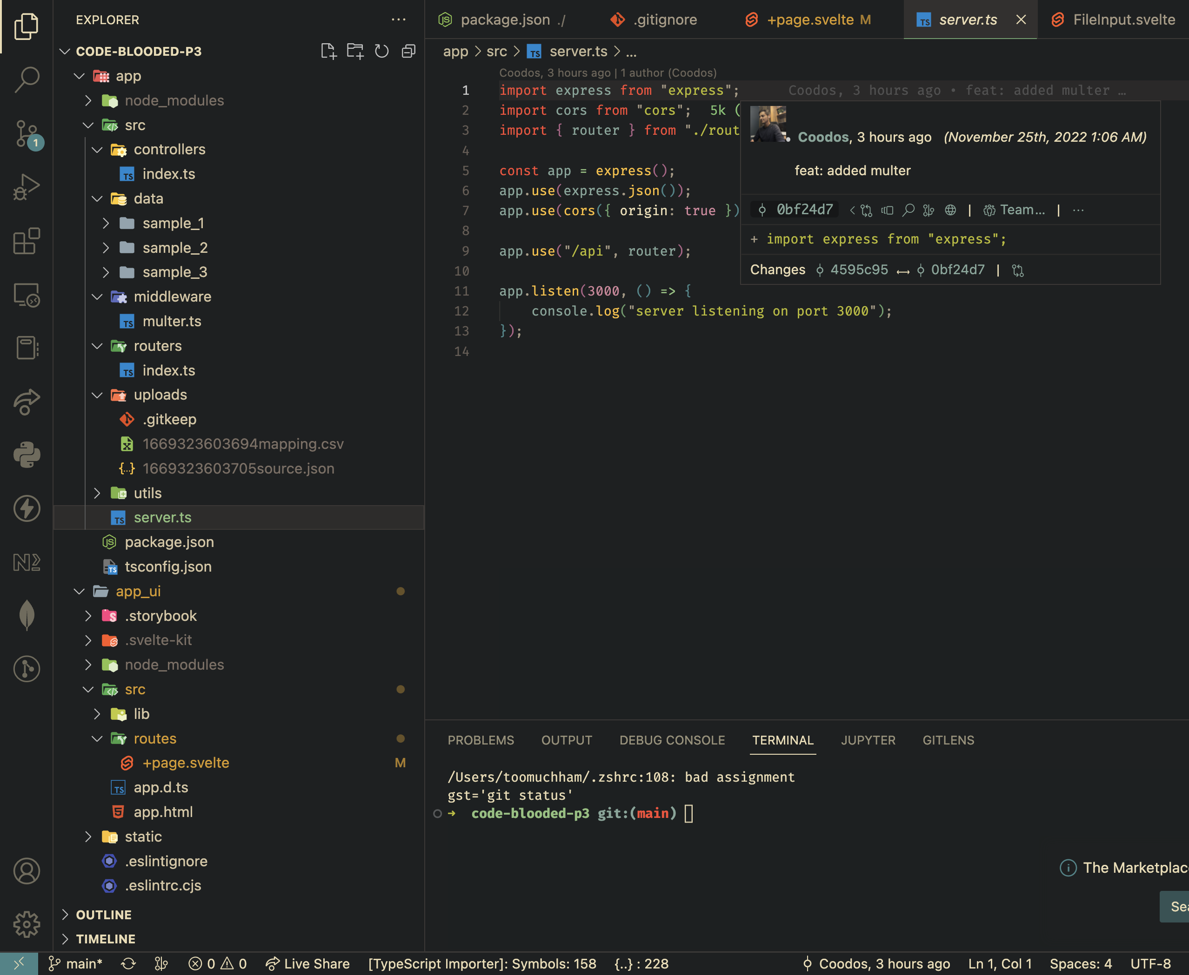
Backend
Our backend has been crafted to perfection with massive consideration for scalability.
All the parsing is done via the help of helper functions which ensure plug and play capability in the future when the next format comes around.

Slide 11
Thank you!
It was a very fun experience to be able to be a part of Code Blooded 4.0 with it’s challenging tasks and fun community!
We had a lot of fun and learning and teaching experiences in making our Awesome JSON Transformer
We hope we get the opportunity to participate again and stay in contact with all the hackers we met! Happy Hacking!

